Slide 1
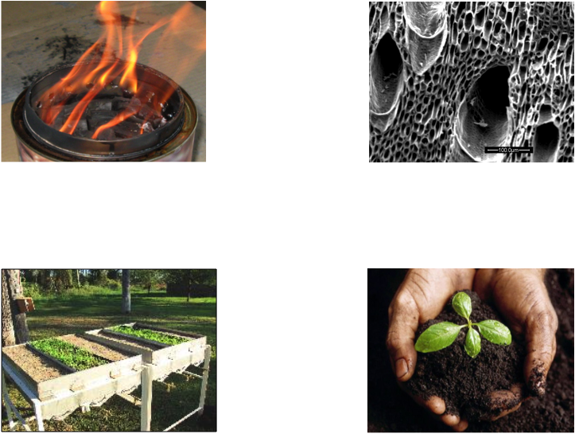
Basic Principles of Pyrolysis Kiln Design

Slide 2
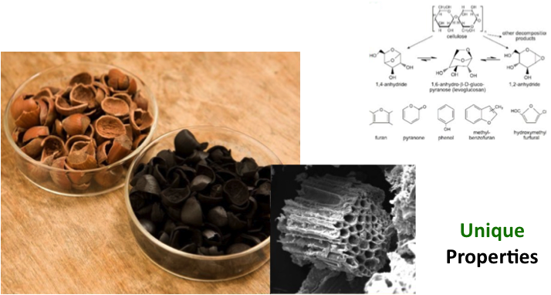
Transformation of Biomass to Biochar
Heating organic matter in absence of air causes complete physical and chemical changes.
Pyrolysis: decomposition (lysys) by fire (pyro)

Slide 3
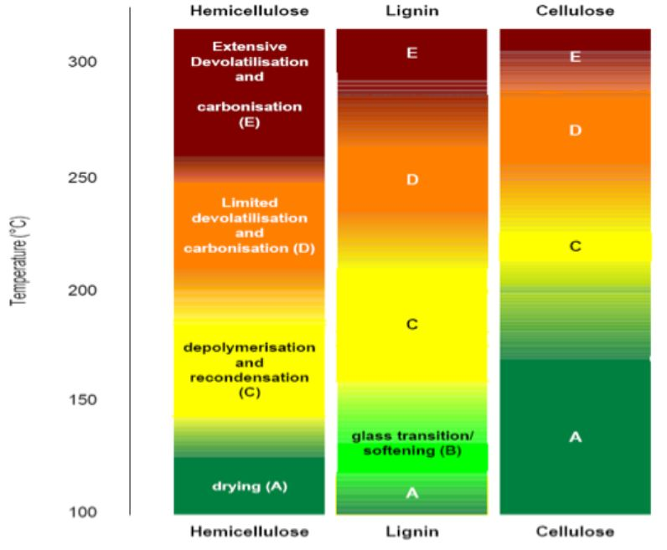
TRANSFORMATION OF BIOMASS UNDER HEAT
Different components pyrolyse at different temperatures
Notes:
Different types of lignin in different bamboos, makes different wood vinegars

Slide 4
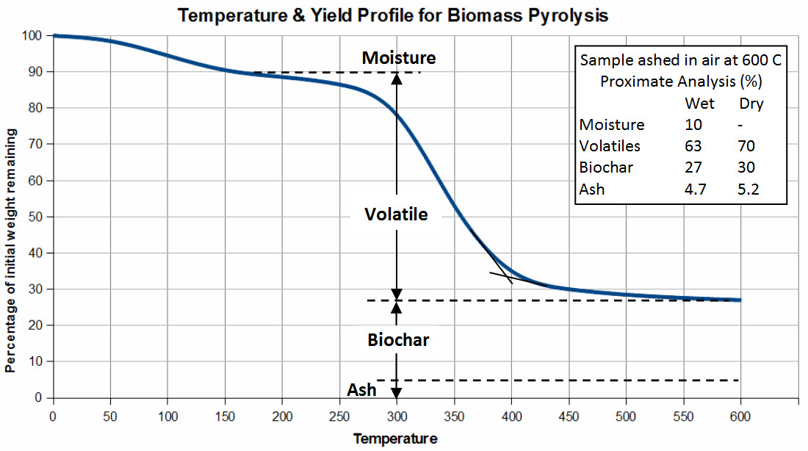
Temperature Yield Profile for Biomass Pyrolysis;
Different Biomass Have Different Curves
% of initial weight remaining
Typical Wood Profile
Temperature

Slide 5
VISUALISATION OF PYROLYSIS PROCESS
OF 25MM CYLINDER OF WOOD
H₂O, CO₂
C_{x}H_{y}O_{z}
H₂, CO, CO₂
CH₄, C_{x}H_{y}O_{z}
H₂O, CO₂
H₂O
CO, CO₂
CxHy
180-250
250 °C -350 °C
180 °C -250 °C
H₂O, CO₂
150-180 °C
H₂O
Heat
150 °C -180 °C
100 °C
Exothermic
Pyrolysis
Heat generated Particle shrinks
25 °C
Heat
100 °C
Heat
Torrefaction
Heat
Conditioning
Drying
Biomass starts to break down

Slide 6
Biochar Can Be Made At Different Temperatures in a few Seconds or Over Many Days
Conditions for Fast Pyrolysis & Combustion
Conditions for Biochar activation with steam and air
800C
Formation of Biochar above this line
Gasification
TEMPERATURE
Slow Pyrolysis
Torrefaction
100C
Seconds
Hours
Days
Weeks
Months
TIME
Notes:
Formation of Biochar: Complex Sugars and Smoke Chemicals form on Surface through dispersion of superheated steam in biomass.
High Availability of NPK and other Nutrients
Torrefaction & Formation of Biochar Mineral Complexes
Anaerobic Digestion/Compost
Biochar reduces time for biomass break down and microbes can chemically activate surface

Slide 7
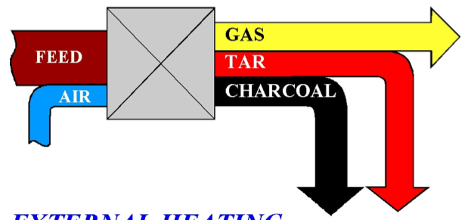
THREE METHODS OF HEATING BIOMASS
VOLATILE LIQUIDS
Biochar
1. Direct Heating

Slide 8
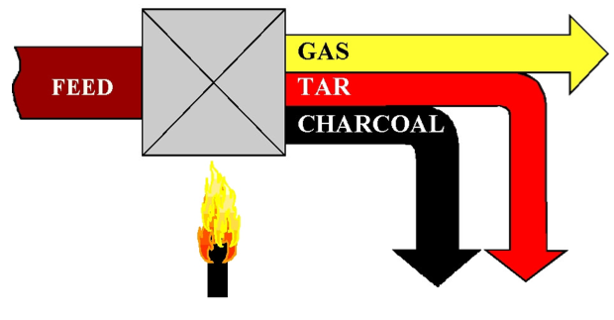
THREE METHODS OF HEATING BIOMASS
VOLATILE LIQUIDS
Biochar
2. Indirect Heating

Slide 9
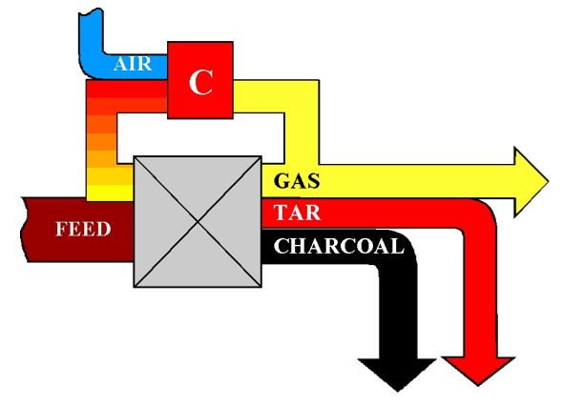
THREE METHODS OF HEATING BIOMASS
VOLATILE LIQUIDS
3. Heating with Recirculated gas

Slide 10
HOW MUCH ENERGY DOES IT TAKE TO MAKE BIOCHAR
A Simple Energy Balance
Energy for Drying
+
Energy for Pyrolysis
+
Energy in the Exhaust Gas
+
Energy from Heat Lost from
Hot Walls of the Kiln
Energy in the Biomass
–
Energy in the biochar
=

Slide 11
Drying Biomass Uses the Most Energy
For every 200gms of water evaporated from your biomass you need to us approximately 1/3 of the total energy content of the dry biomass
pyrolyser
.2kg Water
.2kgsteam
.8kg biomass
.3kg biochar
.5kg gas

Slide 12
Getting Efficient Burning of the Pyrolysis Gases
Pyrolysis gas is difficult to burn cleanly unless you add
sufficient turbulent air that mixes thoroughly
at high temperatures and
remains in a hot reactor for at least 1 to 2 seconds
This is known as the
Time; Temperature; Turbulence principal

Slide 13
Getting Efficient Burning of the Pyrolysis Gases
For every 1000kJ of syngas burnt in a second (1MW) you need 1 cu.m. of combustion volume
For Every kg of syngas you need approximately 2kg of air to burn cleanly
1 Cu. M.
.2kg syngas
.6kg syngas hot gas
.4kg air

Slide 14
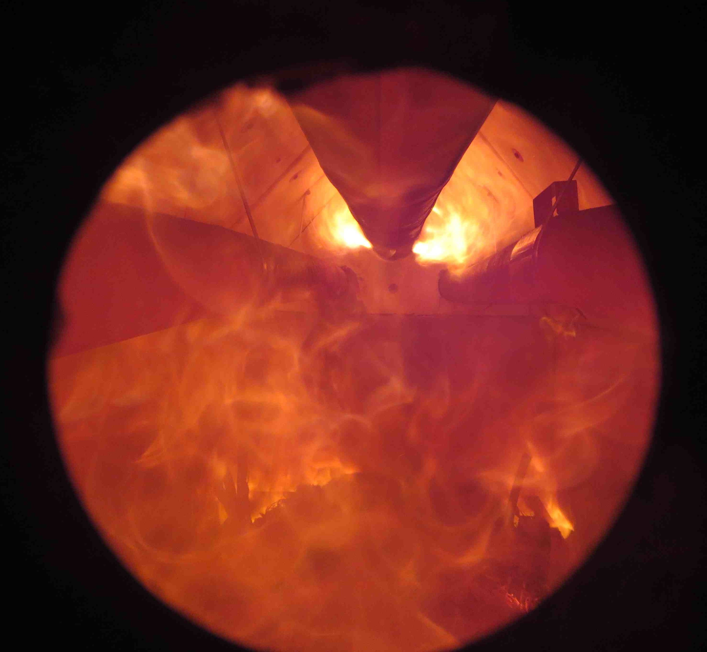
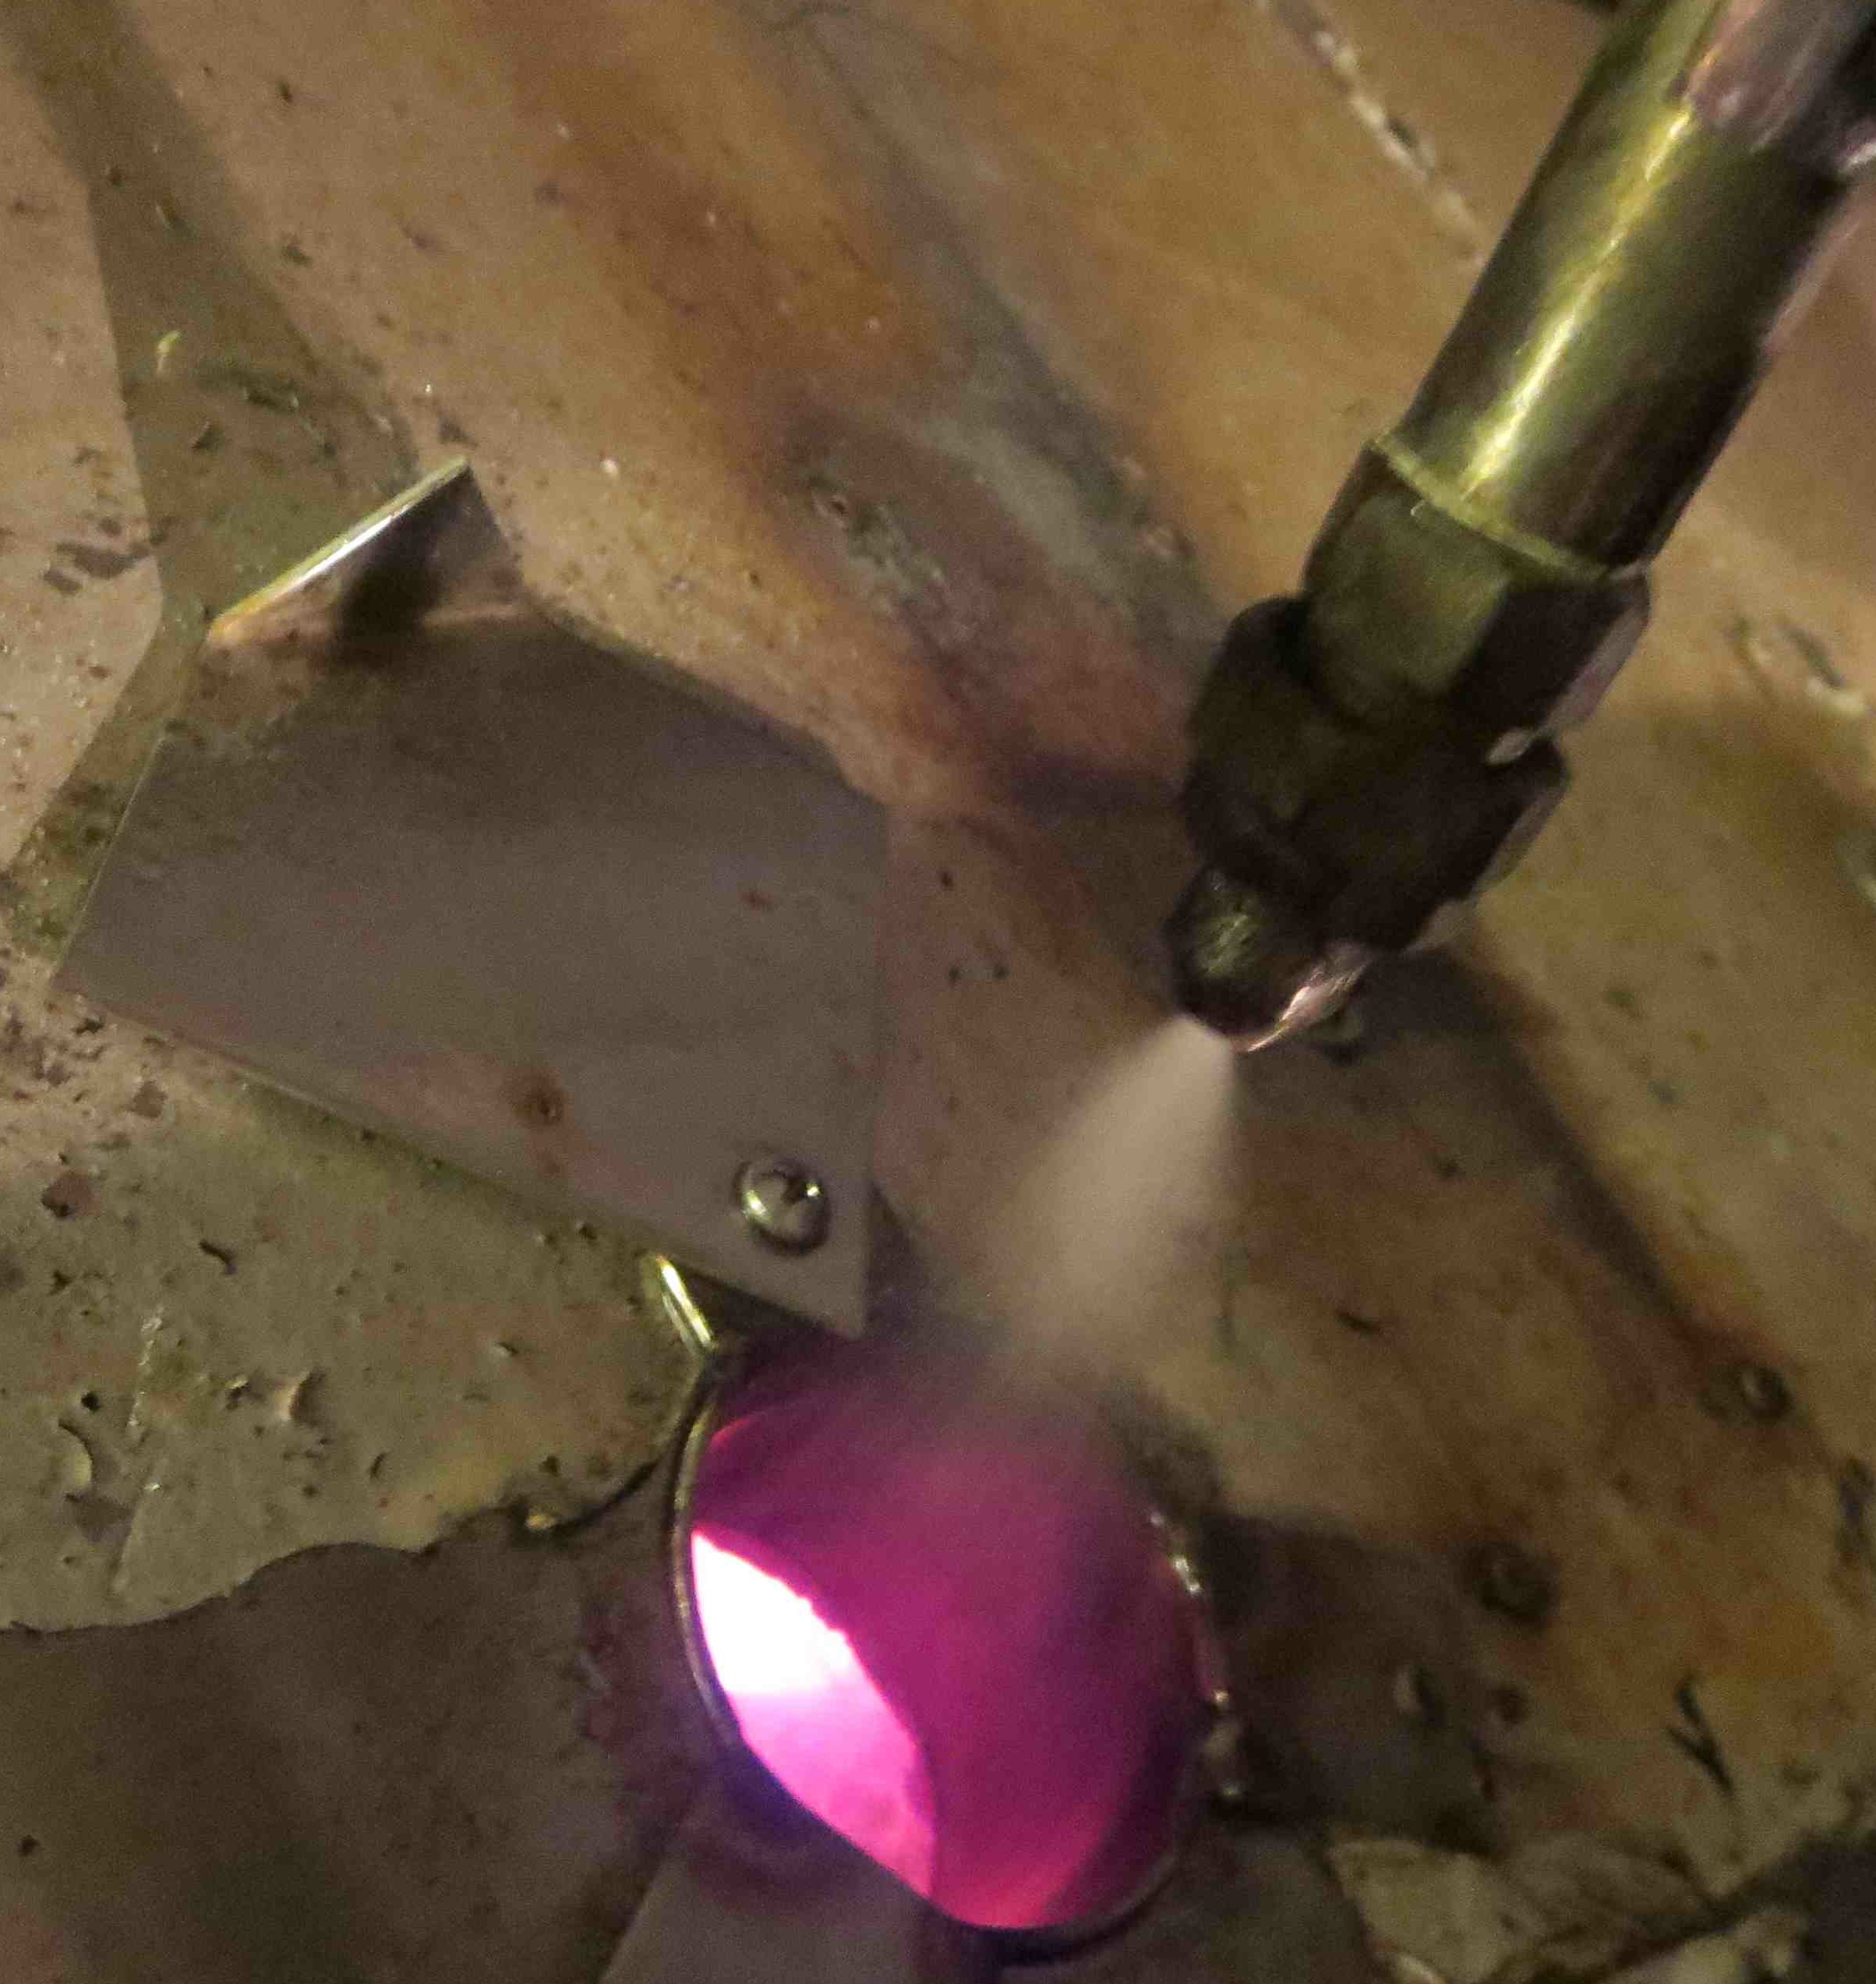
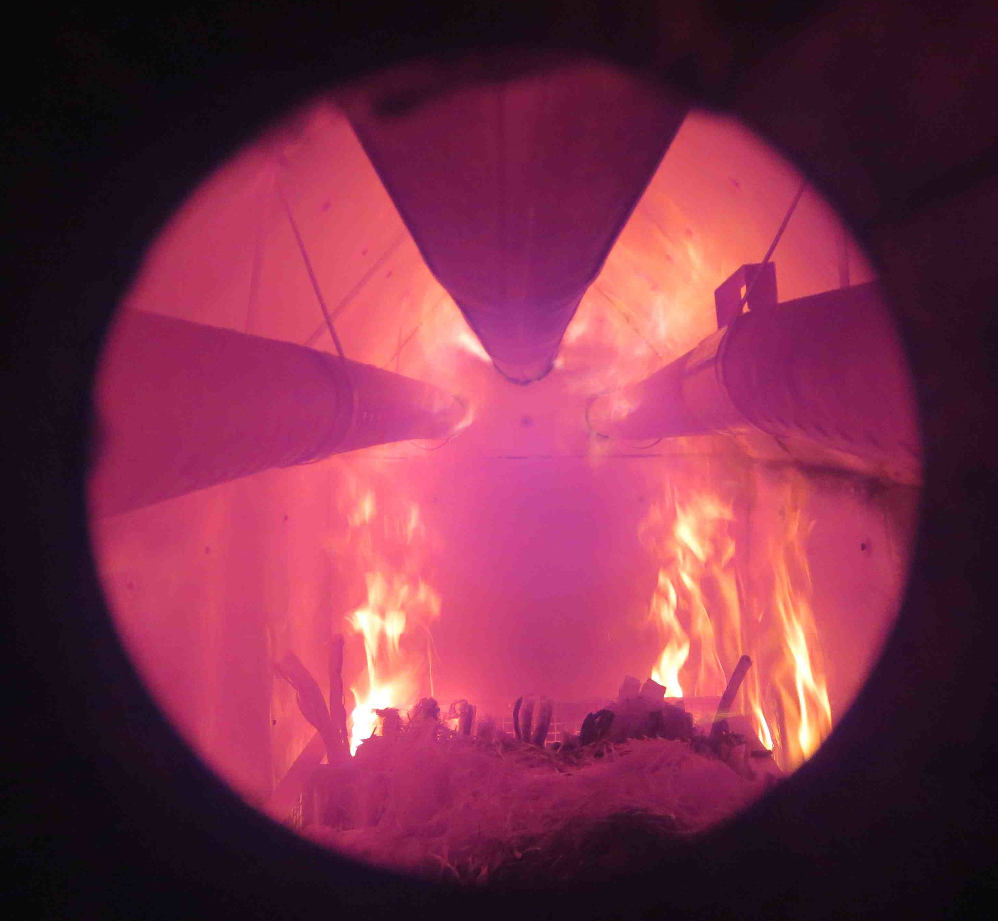
Simple Techniques for Having Clean Combustion
Water jets

Slide 15
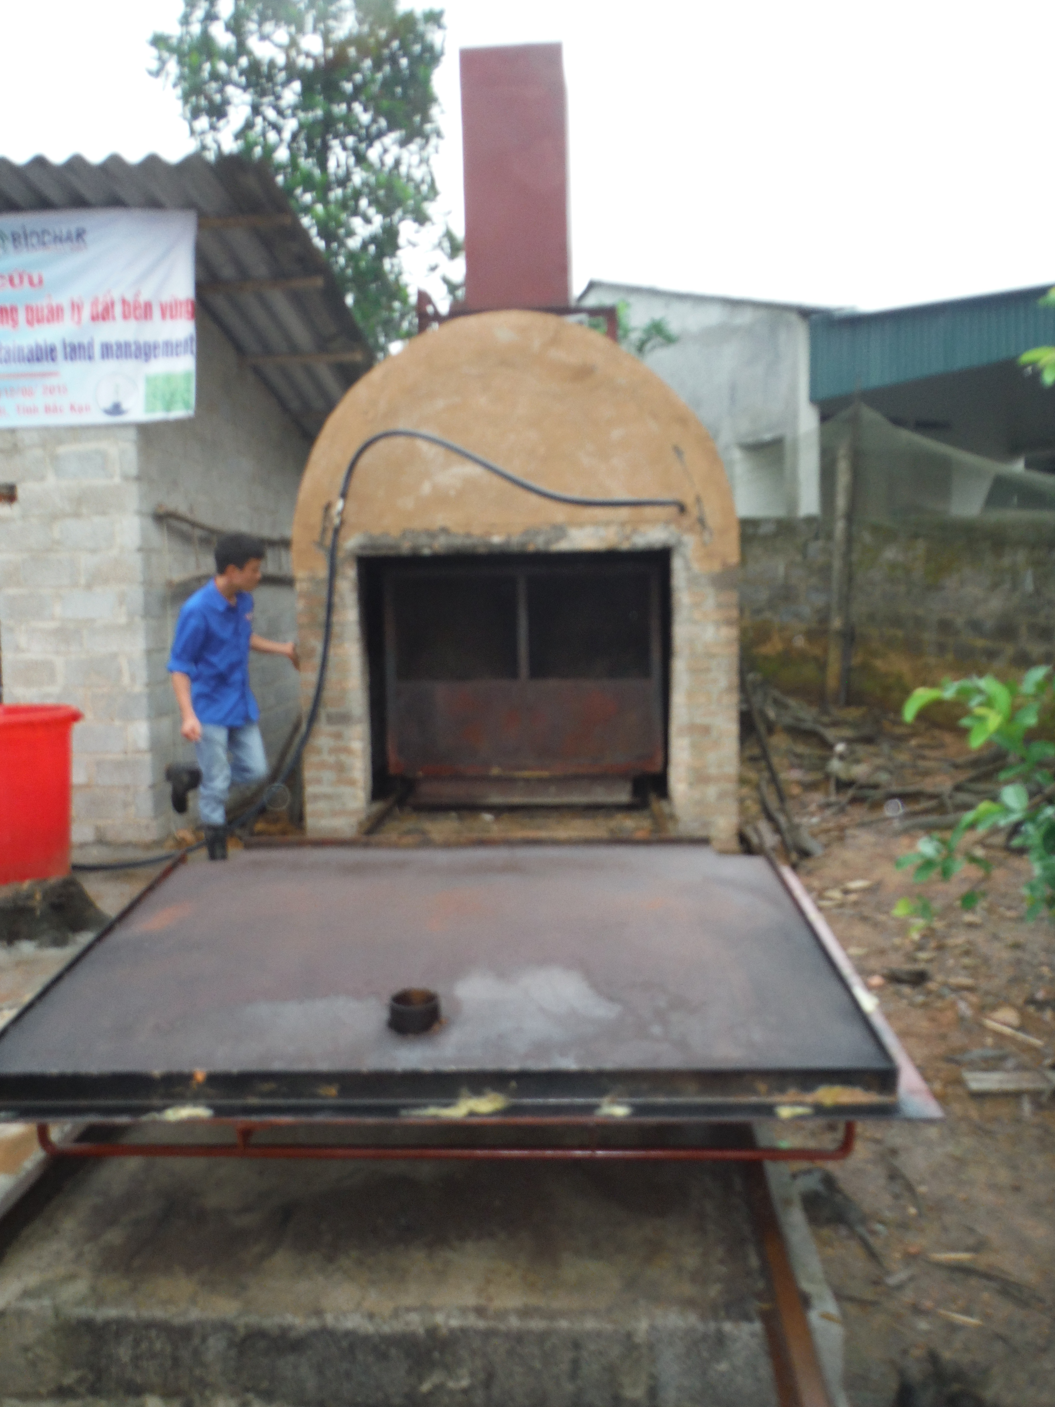
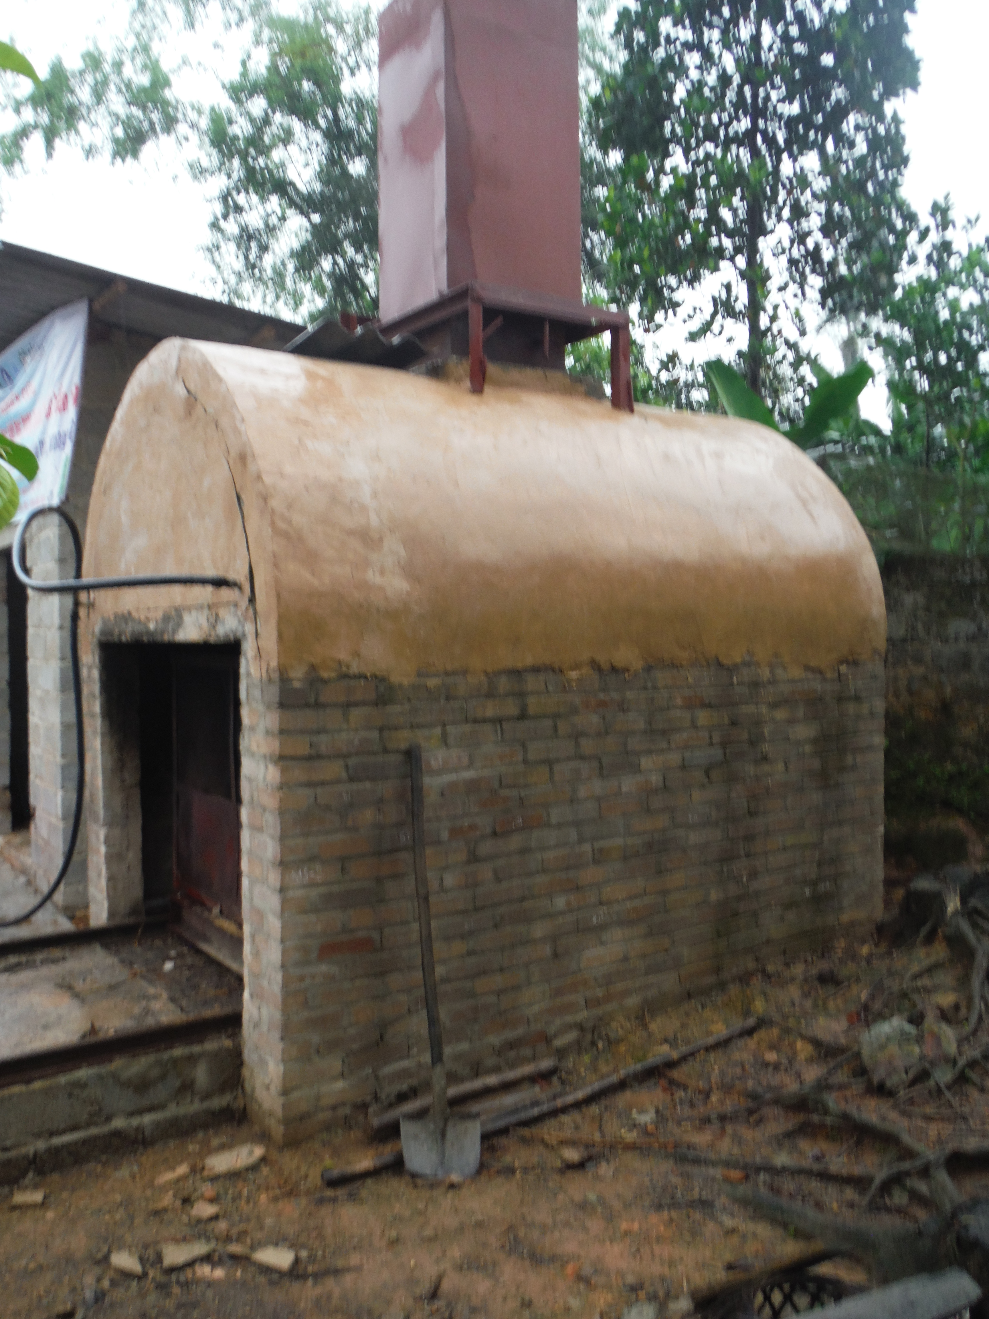
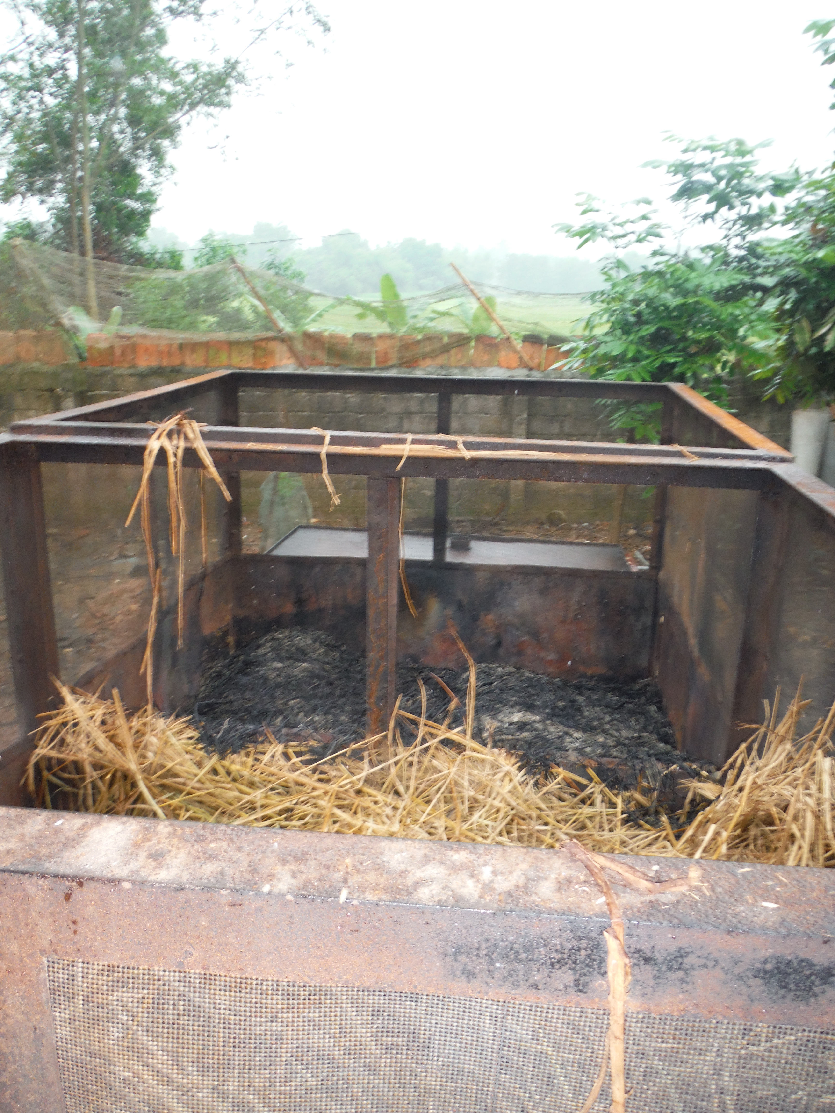
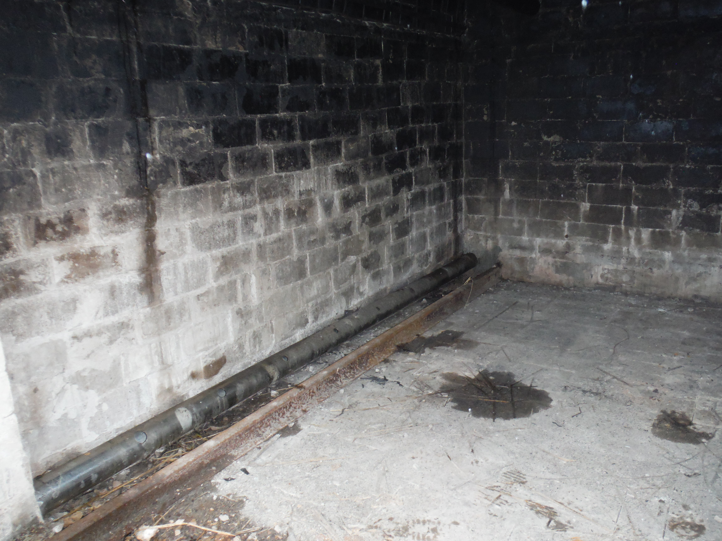
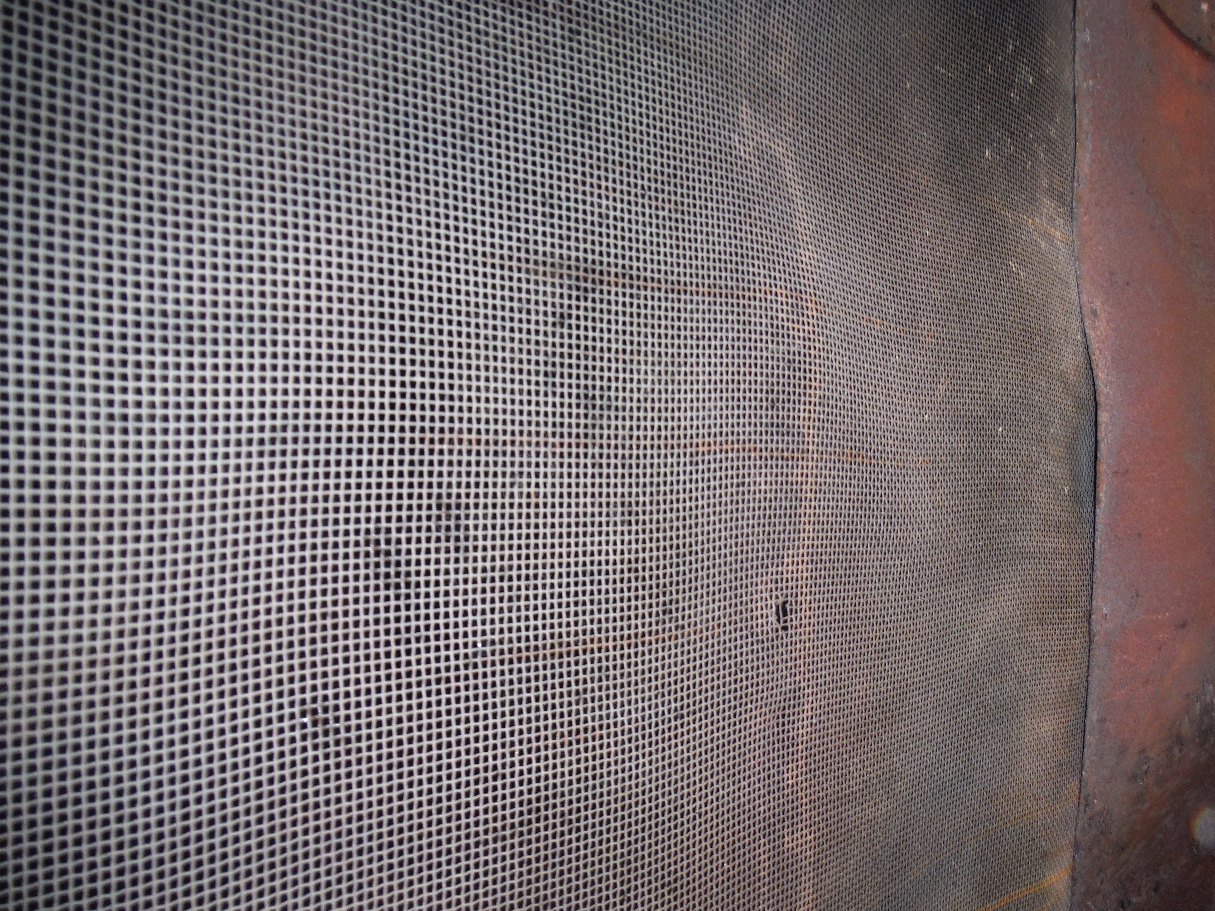
Examination of Cart Kiln
Problem; Kiln is cracking at the front between the wall and the front arch.
Solution. Take out cement and put in a flexible high temperature rope seal
Problem; Water pipe inside kiln and pump is low pressure high flow rate
Solution; Replace with external pipe, spray nozzles and high pressure (4 bar) low flow rate 3-5 litres/minute
Problem; Corrosion on the Steel on the cart as temp. too high.
Solution; Paint with high temp paint. When kiln not in use spray small amount of oil on steel to stop rust forming
Problem; Air is only going to the far end of the pipes where the holes are large and thus only half of the cart has enough heat to make biochar.
Solution; Turn pipe around so big hole at the end where the fan is

Slide 16
Some Simple Rules for Biochar Production
The 2 processes of drying and torrefaction, require external energy. The wetter the feed the greater the energy required.
Therefore, use dry fuel (10%>moisture content<20%). If the biomass is too dry it can reduce yield and quality
Use relatively uniform particle size if possible (5-15mm)
Notes:
STEAM GASIFICATION: is the gasification of biomass using steam > 800°C to yield a producer gas. Heat is added indirectly to the biomass via a solid heat carrier or the steam to effect reaction.
OXYGEN GASIFICATION: is the gasification of biomass using either oxygen-enriched air or pure oxygen to yield a producer gas. Heat may be added indirectly to the biomass via a solid heat carrier to effect reaction.

Slide 17
Some Simple Rules for Biochar Production
Cover highly volatile biomass such as straw with clay to reduce loss of nutrients and increase yields
If possible use steam or combustion gases to heat the biomass to around 200C for as long as possible before entering the pyrolysis zone
Have a feed system where the amount of feed coming into the pyrolyser can be adjusted.
Notes:
STEAM GASIFICATION: is the gasification of biomass using steam > 800°C to yield a producer gas. Heat is added indirectly to the biomass via a solid heat carrier or the steam to effect reaction.
OXYGEN GASIFICATION: is the gasification of biomass using either oxygen-enriched air or pure oxygen to yield a producer gas. Heat may be added indirectly to the biomass via a solid heat carrier to effect reaction.

Slide 18
Some Simple Rules for Biochar Production
Control the temperature using a fine mist of water directed into the flame zone
Spray this water onto the hot biochar to help increase concentration of functional groups and porosity
Use combustion gases from an engine to purge air from the feed material
Coat the hot biochar in a slurry of minerals (ash or rock dust), clay and organic matter to help beneficial micro-organisms grow and provide readily available nutrients to plants
Notes:
STEAM GASIFICATION: is the gasification of biomass using steam > 800°C to yield a producer gas. Heat is added indirectly to the biomass via a solid heat carrier or the steam to effect reaction.
OXYGEN GASIFICATION: is the gasification of biomass using either oxygen-enriched air or pure oxygen to yield a producer gas. Heat may be added indirectly to the biomass via a solid heat carrier to effect reaction.

Slide 19
TERMINOLOGY: PROCESS
COMBUSTION: the reaction of a biomass with air with the intent of completely oxidising it (λ>1).
STOICHIOMETRIC RATIO (λ): the exact air (O₂)/fuel ratio required to completely burn the fuel.
PYROLYSIS: the thermal degradation of biomass in the absence of oxygen to produce condensable vapours, gases, and charcoal; a small amount of air may be admitted to promote this endothermic process (λ < 0.2).
GASIFICATION: conversion, in limited oxygen, of a material into a gas, referred to as ''producer gas'' if the reaction is with air and "syngas" if the reaction is with O₂. The ''ideal'' stoichiometric air/fuel ratio is between 0.3-0.4 to assure complete gasification of the solid fuel and to obtain the optimal heating value of the gas product.
TORREFACTION: the slow heating of biomass in an inert atmosphere at low temperatures (150-250ºC) causing the biomass to de-polymerise and give off a range of low molecular weight compounds.
Notes:
STEAM GASIFICATION: is the gasification of biomass using steam > 800°C to yield a producer gas. Heat is added indirectly to the biomass via a solid heat carrier or the steam to effect reaction.
OXYGEN GASIFICATION: is the gasification of biomass using either oxygen-enriched air or pure oxygen to yield a producer gas. Heat may be added indirectly to the biomass via a solid heat carrier to effect reaction.

