Slide 1
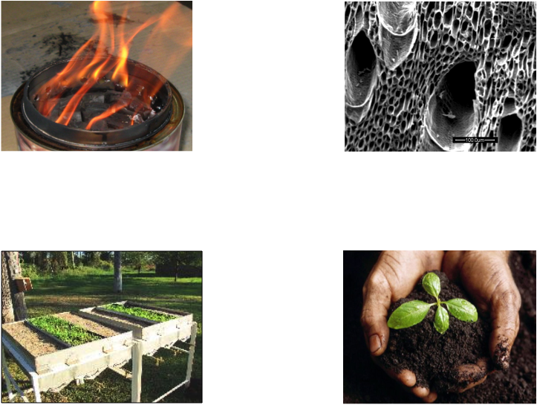
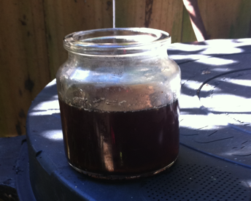
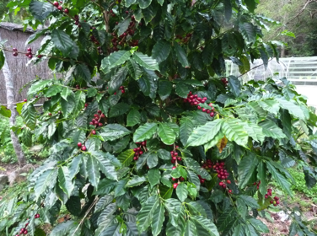
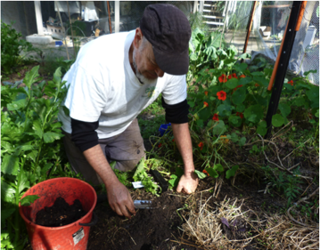
Enhancing the Properties of Biochar Producing Fit for Purpose BC Products

Slide 2
Enhancing Biochars to Meet Constraints A Decision Matrix
Properties of Fresh and Aged Biochar
Soil type (constraint)
Climate, Labour/Social and
Financial Constraints
Crop requirement+ Method of Application

Slide 3
The Context
Most trials carried out with high application rates (> 2 tonnes/ha) with fine dusty material
Many commercial biochars are expensive (>$300/tonne)
Most unprocessed biochars difficult to apply
Results in terms of yields have been variable
Very few economic studies and many of those indicate marginal or no financial benefits to farmers.
Notes:
STEAM GASIFICATION: is the gasification of biomass using steam > 800°C to yield a producer gas. Heat is added indirectly to the biomass via a solid heat carrier or the steam to effect reaction.
OXYGEN GASIFICATION: is the gasification of biomass using either oxygen-enriched air or pure oxygen to yield a producer gas. Heat may be added indirectly to the biomass via a solid heat carrier to effect reaction.

Slide 4
Criteria for Fit For Purpose Engineered Biochars
Utilise local resources as much as possible
Can be applied at a rate that increases farmer profits through increasing yield and/or reducing fertiliser/water/pesticide/labour requirements.
Improve profitability for biochar producer by selling a higher value product that provides benefits at low application rates
Meets national objective such as reduction in greenhouse gas emissions, heavy metal uptake, eutrophication, increase local employment, reduce expenditure on imported fertiliser
Notes:
STEAM GASIFICATION: is the gasification of biomass using steam > 800°C to yield a producer gas. Heat is added indirectly to the biomass via a solid heat carrier or the steam to effect reaction.
OXYGEN GASIFICATION: is the gasification of biomass using either oxygen-enriched air or pure oxygen to yield a producer gas. Heat may be added indirectly to the biomass via a solid heat carrier to effect reaction.

Slide 5
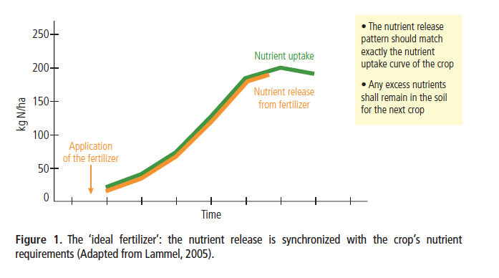
The Ideal Engineered Biochar Based Fertiliser
suppressing diseaase
Provide enough water, macro and micro nutrients and organic compounds to meet the needs of germinating seeds, plants and beneficial micro-organisms when required at a rate that ensures a greater profitability and security against climate change.
The biochar should also assist in suppressing disease and in assisting plant to overcome stresses related to heat/cold/wind.
Notes:
STEAM GASIFICATION: is the gasification of biomass using steam > 800°C to yield a producer gas. Heat is added indirectly to the biomass via a solid heat carrier or the steam to effect reaction.
OXYGEN GASIFICATION: is the gasification of biomass using either oxygen-enriched air or pure oxygen to yield a producer gas. Heat may be added indirectly to the biomass via a solid heat carrier to effect reaction.

Slide 6
Why Do We Enhance Biochars; General Objectives
To increase the return to the farmer through either increasing yield and reducing labour requirements
To improve the profitability for the producer of the biochar
To improve the effectiveness of the biochar for a specific use.
Notes:
STEAM GASIFICATION: is the gasification of biomass using steam > 800°C to yield a producer gas. Heat is added indirectly to the biomass via a solid heat carrier or the steam to effect reaction.
OXYGEN GASIFICATION: is the gasification of biomass using either oxygen-enriched air or pure oxygen to yield a producer gas. Heat may be added indirectly to the biomass via a solid heat carrier to effect reaction.

Slide 7
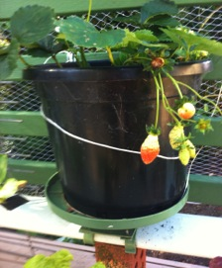
Why Do We Treat Biochars; Specific Objectives
To reduce or eliminate the amount of chemical fertiliser that is applied at the same time increasing yields
To extend the season for harvesting and selling of the crop through the addition of signalling compounds (strawberries start of winter)
Reduce nutrient run off from fields
by adsorption of nutrients to BC
surface
Notes:
STEAM GASIFICATION: is the gasification of biomass using steam > 800°C to yield a producer gas. Heat is added indirectly to the biomass via a solid heat carrier or the steam to effect reaction.
OXYGEN GASIFICATION: is the gasification of biomass using either oxygen-enriched air or pure oxygen to yield a producer gas. Heat may be added indirectly to the biomass via a solid heat carrier to effect reaction.

Slide 8
Why Do We Treat Biochars; Specific Objectives
To improve specific soil properties such as water holding capacity, pH, soil carbon, porosity, bulk density
Increase resistance of plants and animals to disease or other stresses
To reduce take up of heavy metals by plants
Notes:
STEAM GASIFICATION: is the gasification of biomass using steam > 800°C to yield a producer gas. Heat is added indirectly to the biomass via a solid heat carrier or the steam to effect reaction.
OXYGEN GASIFICATION: is the gasification of biomass using either oxygen-enriched air or pure oxygen to yield a producer gas. Heat may be added indirectly to the biomass via a solid heat carrier to effect reaction.

Slide 9
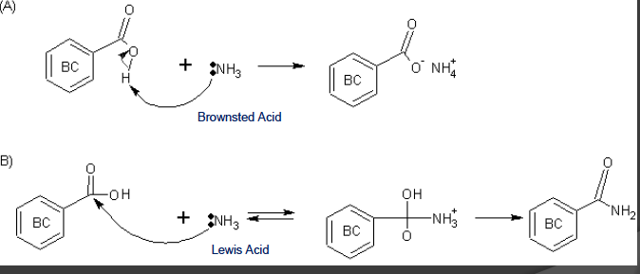
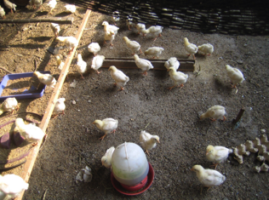
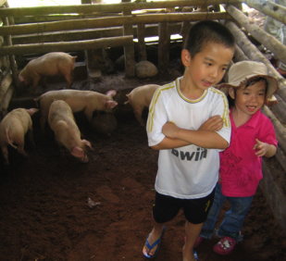
Why Do We Treat Biochars; Increase Surface Functional Groups to Adsorb Ammonia and Nitrates
Ho
Holmes
Holmes and Beebe 1957
Eliminate Ammonia Emissions and Disease from Animal Pens
Improve Weight per Unit of Feed
Adsorb Nutrients From Manure
Can then be Applied Directly to Soil
At Low Application Rates
Note Spokas and Colosky found wood ash worked as well as biochar at adsorption
Notes:
STEAM GASIFICATION: is the gasification of biomass using steam > 800°C to yield a producer gas. Heat is added indirectly to the biomass via a solid heat carrier or the steam to effect reaction.
OXYGEN GASIFICATION: is the gasification of biomass using either oxygen-enriched air or pure oxygen to yield a producer gas. Heat may be added indirectly to the biomass via a solid heat carrier to effect reaction.

Slide 10
Why Do We Treat Biochars; Specific Objectives
To increase the concentration of beneficial micro-organisms especially non nodularising nitrogen fixers and make P available
To make specific nutrients more available that are locked up in soils especially P
To increase the ability to adsorb ammonia and other harmful gases and liquids in animal pens, toilets and biodigestors
Notes:
STEAM GASIFICATION: is the gasification of biomass using steam > 800°C to yield a producer gas. Heat is added indirectly to the biomass via a solid heat carrier or the steam to effect reaction.
OXYGEN GASIFICATION: is the gasification of biomass using either oxygen-enriched air or pure oxygen to yield a producer gas. Heat may be added indirectly to the biomass via a solid heat carrier to effect reaction.

Slide 11
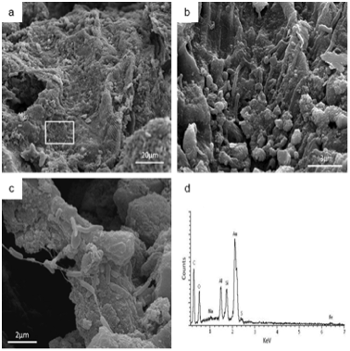
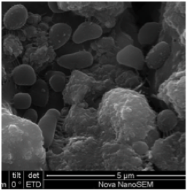
Microbes Growing on a wood biochar that has been treated with Phosphoric acid and then had clay, minerals and manure added to the surface
High concentration of biofilms with high conc. of microbes with an abundance of Non Nodularising Nitrogen Fixers.

Slide 12
: Methods of Pretreatment of Mixed Biomass Feed
Mix Biomass with wet high iron bearing clay, iron sulphate, ash, other minerals as needed
Partial aerobic composting with minerals and wet manure;
Soaking in nutrient rich ponds and solar drying
Passing nutrient rich liquid through a biofilter
Note; Some species of wood and bamboo are the most effective at soaking up nutrients
Notes:
STEAM GASIFICATION: is the gasification of biomass using steam > 800°C to yield a producer gas. Heat is added indirectly to the biomass via a solid heat carrier or the steam to effect reaction.
OXYGEN GASIFICATION: is the gasification of biomass using either oxygen-enriched air or pure oxygen to yield a producer gas. Heat may be added indirectly to the biomass via a solid heat carrier to effect reaction.

Slide 13
Choose the Most Effective Biochar (s) Before Doing Any Pre or Post Treatment
Notes:
STEAM GASIFICATION: is the gasification of biomass using steam > 800°C to yield a producer gas. Heat is added indirectly to the biomass via a solid heat carrier or the steam to effect reaction.
OXYGEN GASIFICATION: is the gasification of biomass using either oxygen-enriched air or pure oxygen to yield a producer gas. Heat may be added indirectly to the biomass via a solid heat carrier to effect reaction.

Slide 14
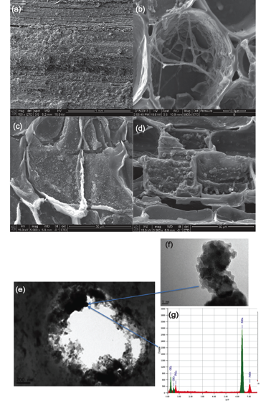
Methods of Pre-Treatment; Forming Organo-Mineral Nanostructures in Macropores and Mesopores
Biomass can be soaked in solutions or mixed with a slurries that are rich in minerals, chemicals and/or organic compounds which can then migrate into the macro and mesopores;
Image of Bamboo soaked in clay and FeSO4
Notes:
STEAM GASIFICATION: is the gasification of biomass using steam > 800°C to yield a producer gas. Heat is added indirectly to the biomass via a solid heat carrier or the steam to effect reaction.
OXYGEN GASIFICATION: is the gasification of biomass using either oxygen-enriched air or pure oxygen to yield a producer gas. Heat may be added indirectly to the biomass via a solid heat carrier to effect reaction.

Slide 15
: Methods of Pretreatment of Mixed Biomass Feed
Mixing with a phosphorous rich acid or a potassium rich alkali,
Adding small amounts of urea, KCl and or DAP with an expanding clay and adjusting pH to 7. The clay helps to prevent loss of N
Coating the biomass in a slurry of manure, clay, ash and rock dust
Notes:
STEAM GASIFICATION: is the gasification of biomass using steam > 800°C to yield a producer gas. Heat is added indirectly to the biomass via a solid heat carrier or the steam to effect reaction.
OXYGEN GASIFICATION: is the gasification of biomass using either oxygen-enriched air or pure oxygen to yield a producer gas. Heat may be added indirectly to the biomass via a solid heat carrier to effect reaction.

Slide 16
: Key Points; Biochar Can Act as a Catalyst
Adding small amounts of pre and post treated biochar (<150kg/ha) can have a larger affect especially if added with NPK
Pretreteated Biochar can improve the quality and effectiveness of compost if added at around 500kg/ha
Ash that is high in Amorphous Silica seems to promote plant resistance to stress and also is involved in locking up heavy metals. In rice systems if appears associated with fungal growth
Notes:
STEAM GASIFICATION: is the gasification of biomass using steam > 800°C to yield a producer gas. Heat is added indirectly to the biomass via a solid heat carrier or the steam to effect reaction.
OXYGEN GASIFICATION: is the gasification of biomass using either oxygen-enriched air or pure oxygen to yield a producer gas. Heat may be added indirectly to the biomass via a solid heat carrier to effect reaction.

Slide 17
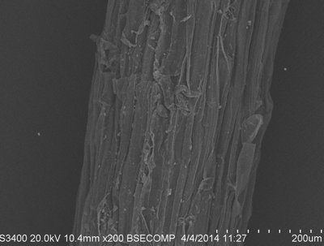
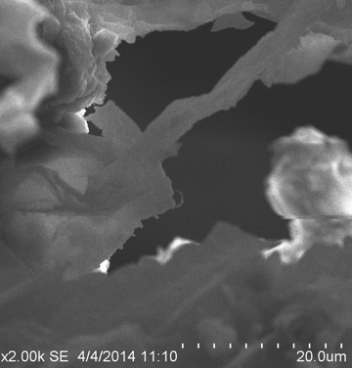
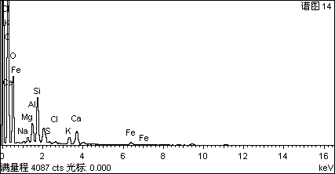
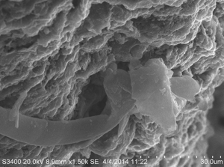
: Key Points; Biochar Can Act as a Catalyst
Root without Biochar
Notes:
STEAM GASIFICATION: is the gasification of biomass using steam > 800°C to yield a producer gas. Heat is added indirectly to the biomass via a solid heat carrier or the steam to effect reaction.
OXYGEN GASIFICATION: is the gasification of biomass using either oxygen-enriched air or pure oxygen to yield a producer gas. Heat may be added indirectly to the biomass via a solid heat carrier to effect reaction.

Slide 18
: Key Points; Biochar Can Act as a Catalyst
Ash that is high in Amorphous Silica seems to promote plant resistance to stress and also is involved in locking up heavy metals.
Nanophase iron (Fe) particles appear to be very important in a range of biotic and abiotic processes involved in making N and P more available to plants
Fungi may migrate to pores that have high contents of P Ca, Clay and also K(need more evidence)
Notes:
STEAM GASIFICATION: is the gasification of biomass using steam > 800°C to yield a producer gas. Heat is added indirectly to the biomass via a solid heat carrier or the steam to effect reaction.
OXYGEN GASIFICATION: is the gasification of biomass using either oxygen-enriched air or pure oxygen to yield a producer gas. Heat may be added indirectly to the biomass via a solid heat carrier to effect reaction.

Slide 19
Why do We Make Biochar From Mixed Feed Stock, Clay, Ash and Rock Dust
To increase the amount and range of macro (NPK) and micro nutrients.
Some clays can increase the Cation Exchange Capacity by increasing the number of acid functional groups
To increase the yield of the biochar by condensing smoke on the surface of the clay and other minerals
To provide a range of smoke water chemicals (phenols, ketones, carboxylic acids) for increased germination and resistance to disease
Notes:
STEAM GASIFICATION: is the gasification of biomass using steam > 800°C to yield a producer gas. Heat is added indirectly to the biomass via a solid heat carrier or the steam to effect reaction.
OXYGEN GASIFICATION: is the gasification of biomass using either oxygen-enriched air or pure oxygen to yield a producer gas. Heat may be added indirectly to the biomass via a solid heat carrier to effect reaction.

Slide 20
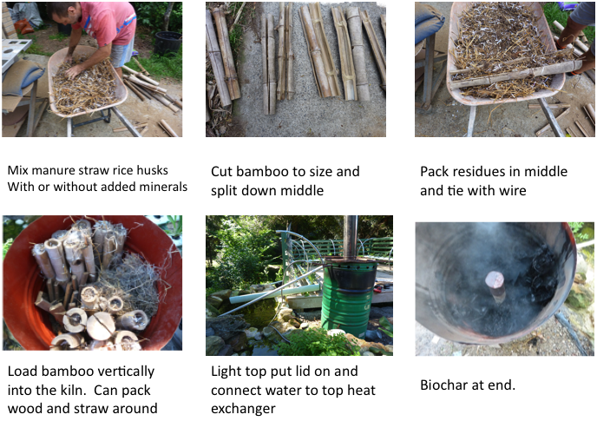
Multiple Feedstocks Made at different Temps Can Match Conflicts in Soil and Plant Needs. Bamboo Chicken Manure Straw Composite BC

Slide 21
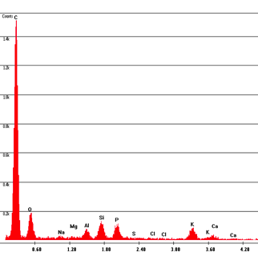
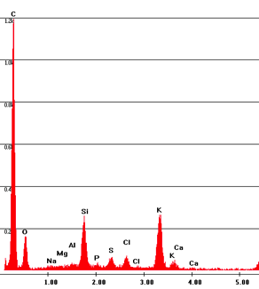
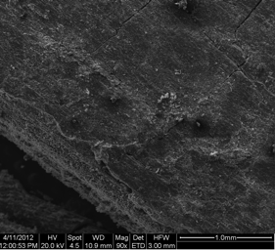
Bamboo with Chicken Manure placed inside and pyrolysed at an Average temperature of 550C. Note internal surfaces are coated with minerals
1
2

Slide 22
Long Term Field Testing of Wood, Rice Straw Rice Husks Clay Activated Biochar with NPK or Compost and NPK ; Hypotheses
Significant increase in yields with reduced greenhouse gas emissions can be achieved by adding small quantities of biochar made from mixed feedstock applied with NPK when applied to sandy loam soils
Making compost with 5% biochar (250kg/ha) and applying at 5 tonnes/ha with NPK every crop cycle will result in an increase in yield and an increase in organic carbon .
Addition of 50% of farmer practice of NPK plus with biochar can achieve the same rice yield as adding 100% NPK.

Slide 23
Field site: 8 treatments
Control ; no additions
50% NPK
100% NPK: (100kg N + 90kg P2O5 + 60Kg K2O/ha in Spring season; 80kg N + 60kg P2O5 + 60Kg K2O/ha in Summer season)
0.5t/ha BC + 50%NPK (BC+50%NPK)
0.5t/ha BC + 100 % NPK (BC+100%NPK)
5 tonnes compost /ha + 50% NPK (CP+50%NPK)
5 tonnes compost + 250kg BC/ha + 50% NPK (CPBC+50%NPK)
5 tonnes compost + 250kg BC/ha + 100% NPK (CPBC+100%NPK)

Slide 24
The highest yields occurred during the first trial in spring 2013 with no differences between treatment although significant increase over control.
The second and third seasons there was flooding and yield decreased although both and BC + compost/NPK had a significant improvement in yield compared to other treatments and biochar + NPK was significantly greater than both NPK treatments.
BC+ 100% NPK and CP+50%NPK made a small difference in spring 2014
Although there were heavy rains the combination of compost made with biochar + 100%NPK made a significant difference in summer 2013 and 2014.
Why the different results in different seasons and why the consistent result with compost made with biochar and NPK?

Slide 25
Fifth Season confirms that the Compost Made with 250kg/ha of Biochar + 100% NPK Provides the Greatest Yield. This is Followed By 500kg/ha of BC + 100% NPK.

Slide 26
Why Soak Biomass In Nutrient Rich Ponds Or Flow Nutrient Rich Water through A Biofilter
Soaking in nutrient rich ponds or in a biofilter;
Partial Aerobic composting with minerals and manure;
Mixing with and phosphorous rich acid or a potassium rich alkali,
Adding small amounts of urea, KCl and or DAP with an expanding clay and adjusting pH to 7. The clay helps to prevent loss of N
Coating the biomass in a slurry or manure, clay, ash and rock dust
Mixtures of the above
Notes:
STEAM GASIFICATION: is the gasification of biomass using steam > 800°C to yield a producer gas. Heat is added indirectly to the biomass via a solid heat carrier or the steam to effect reaction.
OXYGEN GASIFICATION: is the gasification of biomass using either oxygen-enriched air or pure oxygen to yield a producer gas. Heat may be added indirectly to the biomass via a solid heat carrier to effect reaction.

Slide 27
Why Soak Biomass In Nutrient Rich Ponds, In A Biofilter or Aerobically compost with minerals
These pre treatments softens the biomass and makes it easier to pyrolyse
Clay, very fine mineral particles and soluble nutrients can flow into the pores of the biomass
Microbes will form on the surface of the biomass and when pyrolyse add to the nutrient content
When the biomass is pyrolysed the nutrients react with the char and the volatile gases to form tiny micron sized particles. These particles can dissolved slowly and provide plants with esserntial nutrients.
Probably encourage growth of micro-organisms
Notes:
STEAM GASIFICATION: is the gasification of biomass using steam > 800°C to yield a producer gas. Heat is added indirectly to the biomass via a solid heat carrier or the steam to effect reaction.
OXYGEN GASIFICATION: is the gasification of biomass using either oxygen-enriched air or pure oxygen to yield a producer gas. Heat may be added indirectly to the biomass via a solid heat carrier to effect reaction.

Slide 28
Case Study; Enhancing NPK using Pretreated Mixed Biochar For Growing Seed Potatoes
Material | % Dry Weight
Wheat Straw | 60%
Poultry Litter | 25%
Bentonite/Iron Bearing Kaolinite | 5%
Basalt dust | 4%
Wheat Straw Ash | 6%
Notes:
60% Wheat Straw.
25% Poultry litter.
5% Bentonite.
4% Basalt dust.
6% Wheat straw ash.
Pyrolysed at 400-450c.
Biochar pH brought back to 7.5 with phosphoric acid.

Slide 29
Case Study; Enhancing NPK using Pretreated Mixed Biochar
Make ash by taking the biochar from the pyrolyser at 350C, wet and add finely ground basalt and micro nutrients
mix and make into a fine slurry
then add clay
and then coat straw and chicken litter and allow to dry slowly
pyrolyse at 425°C-450°C
adjust pH to 7.5 with 50% solution of Phosphoric acid
Mix NPK and biochar and allow to stand in bag for 2 weeks at different percentages. Total Fertiliser biochar mixture 778kg/ha
Notes:
60% Wheat Straw.
25% Poultry litter.
5% Bentonite.
4% Basalt dust.
6% Wheat straw ash.
Pyrolysed at 400-450c.
Biochar pH brought back to 7.5 with phosphoric acid.

Slide 30
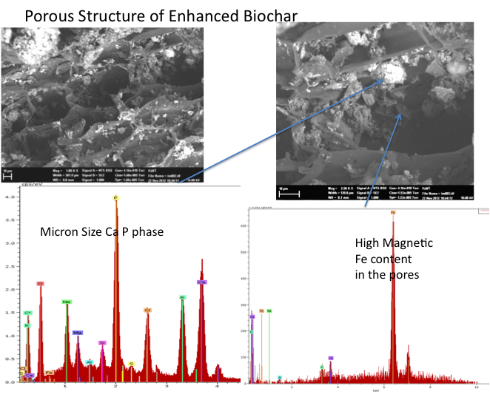
Porous Structure and High Nutrient Content of Biochar

Slide 31
Why do We Treat Biomass with KOH Made From Ash and Phosphoric Acid
To increase the amount of potassium or phosphorus in the biochar that can be released slowly
To soften the fibers and promote more rapid pyrolysis and increases yield of biochar
To increase the type and percentage of different oxygen functional groups and water soluble organic molecules which can increase the ability of the biochar to hold onto and take up nutrients
Notes:
STEAM GASIFICATION: is the gasification of biomass using steam > 800°C to yield a producer gas. Heat is added indirectly to the biomass via a solid heat carrier or the steam to effect reaction.
OXYGEN GASIFICATION: is the gasification of biomass using either oxygen-enriched air or pure oxygen to yield a producer gas. Heat may be added indirectly to the biomass via a solid heat carrier to effect reaction.

Slide 32
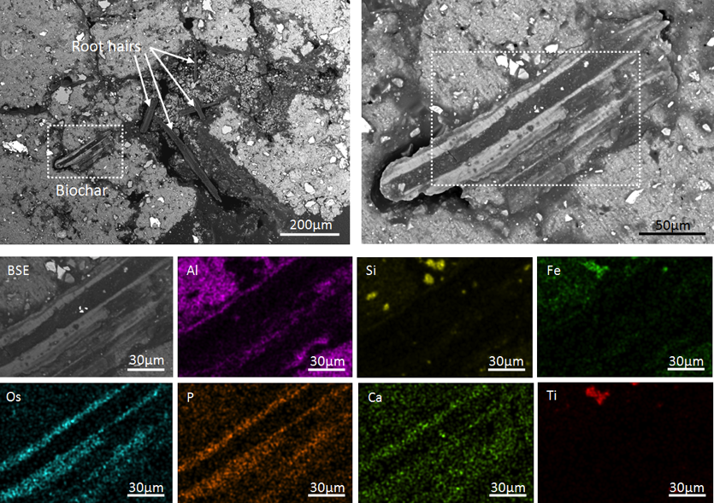
Baking Minerals, Manure and Clay on Biochar Can Result in Increase in Biochar Pores and Surfaces Having High P, Ca and Fe

Slide 33
Adding Urea, DAP, Rock Phosphate and or KCl with Clay to Biomass
1. To increase the concentration of macronutrients that will be slowly released.
Note pyrolysis must be carried out at low temperature reduce loss of N
2. To Increase the Cation Exchange Capacity of the biochar and adsorb toxic metals and organic compounds
3. To potentially increase the stability of the biochar when Apatite is added

Slide 34
Adding Iron oxide (Rust) and or Bentonite of Kaolinitc Clay to Biomass
Improves the ability of biochar to adsorb and release plant available nutrients especially nitrates when biochars made at temperatures over 700C and phosphates at temperatures of less than 425C
With Iron makes biochar magnetic and helps to lock up heavy metals and toxic organic compounds and help reduce Greenhouse gas emissions
Can increase the CEC and stability of the biochar .
Notes:
STEAM GASIFICATION: is the gasification of biomass using steam > 800°C to yield a producer gas. Heat is added indirectly to the biomass via a solid heat carrier or the steam to effect reaction.
OXYGEN GASIFICATION: is the gasification of biomass using either oxygen-enriched air or pure oxygen to yield a producer gas. Heat may be added indirectly to the biomass via a solid heat carrier to effect reaction.

Slide 35
: Methods of Post - Treatment of Biochar
Activating the surface of the biochar by quenching biochar with fine mist of water in the pyrolyser has the following affect
Increases the cation exchange capacity of the biochar by increasing the number of COOH and C=O groups which in turn can increase the amount of nutrients that can be retained
Increases the surface area and pore volume for adsorption of water and nutrients
Notes:
STEAM GASIFICATION: is the gasification of biomass using steam > 800°C to yield a producer gas. Heat is added indirectly to the biomass via a solid heat carrier or the steam to effect reaction.
OXYGEN GASIFICATION: is the gasification of biomass using either oxygen-enriched air or pure oxygen to yield a producer gas. Heat may be added indirectly to the biomass via a solid heat carrier to effect reaction.

Slide 36
Methods of Post Treatment; Forming Organo-Mineral Nanostructures in Macropores and Mesopores and increasing Functional Groups on the Surfaces
OH
P
O⁻
K⁺
OK
O=S=O
H
H-N-H
Notes:
STEAM GASIFICATION: is the gasification of biomass using steam > 800°C to yield a producer gas. Heat is added indirectly to the biomass via a solid heat carrier or the steam to effect reaction.
OXYGEN GASIFICATION: is the gasification of biomass using either oxygen-enriched air or pure oxygen to yield a producer gas. Heat may be added indirectly to the biomass via a solid heat carrier to effect reaction.

Slide 37
: Adding mixture of clay, minerals, digestate, manure, ash to hot biochar
The manures and digestate provide additional N and P as well as a range of to the surface
The manures and digestate can also be food for micro-organisms.
The ash provides a range of micronutrients and usually K and Si and some P, Ca and Mg
Notes:
STEAM GASIFICATION: is the gasification of biomass using steam > 800°C to yield a producer gas. Heat is added indirectly to the biomass via a solid heat carrier or the steam to effect reaction.
OXYGEN GASIFICATION: is the gasification of biomass using either oxygen-enriched air or pure oxygen to yield a producer gas. Heat may be added indirectly to the biomass via a solid heat carrier to effect reaction.

Slide 38
: Methods of Post -treatment of Biochar
Feeding biochar to animals and then pelleting/granulating manure/biochar with clay, and other sources of micro and macronutrients
Composting the biochar and then removing biochar from compost and adding additional N and/or P liquid.
Boiling biochar in water and then filtering. Add biochar to the NPK fertiliser at about 10%. The ilquid is used as a foliar spray
Boil biochar with KOH and then add Phosphoric acid and FeSO4
Notes:
STEAM GASIFICATION: is the gasification of biomass using steam > 800°C to yield a producer gas. Heat is added indirectly to the biomass via a solid heat carrier or the steam to effect reaction.
OXYGEN GASIFICATION: is the gasification of biomass using either oxygen-enriched air or pure oxygen to yield a producer gas. Heat may be added indirectly to the biomass via a solid heat carrier to effect reaction.

Slide 39
: Methods of Post -treatment of Biochar
Mixing biochar with clay, other minerals, KCl, urea, diamonium phosphate and allowing to stand in closed vessels.
Boiling biochar in water and then filtering. The liquid is used as a foliar spray. The biochar can then be further processed by adding into compost/acidified and/or mixed with source of N/P/K
Boil biochar with KOH and then add Phosphoric acid and FeSO4 to produce a liquid fertiliser
Notes:
STEAM GASIFICATION: is the gasification of biomass using steam > 800°C to yield a producer gas. Heat is added indirectly to the biomass via a solid heat carrier or the steam to effect reaction.
OXYGEN GASIFICATION: is the gasification of biomass using either oxygen-enriched air or pure oxygen to yield a producer gas. Heat may be added indirectly to the biomass via a solid heat carrier to effect reaction.

Slide 40
Mixing pretreated biochar with clay and NPK; Different Biochars with Rice
AB
D
Yield (Tonnes/ha)
CCF MS-BCF PH-BCF HW-BCF WS-BCF
Chemical compound fertilizer (CCF), maize straw (MS-BCF), peanut husk (PH-BCF), household waste (HW-BCF) and wheat straw (MW-BCF)) applied at 500kg/ha to rice paddy (Joseph et al 2013)
Notes:
STEAM GASIFICATION: is the gasification of biomass using steam > 800°C to yield a producer gas. Heat is added indirectly to the biomass via a solid heat carrier or the steam to effect reaction.
OXYGEN GASIFICATION: is the gasification of biomass using either oxygen-enriched air or pure oxygen to yield a producer gas. Heat may be added indirectly to the biomass via a solid heat carrier to effect reaction.

Slide 41
Mixing pretreated biochar with clay and NPK; Different Biochars with Rice
AB
Treatment | total nitrogen/(kg/ha ) | partial factor productivity of nitrogen/( kg/kg ) | The grain harvest index/( kg/kg ) | nitrogen harvest index/( kg/kg ) | nitrogen grain production efficiency of the crop/( kg/kg )
BBF | 210. 08 | 39. 09^{dC} | 0. 24^{cB} | 0. 70^{cD} | 46. 09^{dD}
WSF | 168. 05 | 68. 05^{aA} | 0. 28^{aA} | 0. 76^{bAB} | 56. 57^{aA}
MSF | 168. 05 | 52. 15^{cB} | 0. 26^{abAB} | 0. 76^{bB} | 55. 85^{aA}
PHF | 168. 05 | 60. 48^{abcAB} | 0. 28^{aA} | 0. 72^{cC} | 53. 07^{bB}
PMF | 168. 05 | 53. 54^{bcB} | 0. 25^{bcAB} | 0. 75^{bB} | 50. 72cC
HWF | 168. 05 | 62. 01^{abAB} | 0. 27^{abA} | 0. 79^{aA} | 57. 03^{aA}
D
Notes:
STEAM GASIFICATION: is the gasification of biomass using steam > 800°C to yield a producer gas. Heat is added indirectly to the biomass via a solid heat carrier or the steam to effect reaction.
OXYGEN GASIFICATION: is the gasification of biomass using either oxygen-enriched air or pure oxygen to yield a producer gas. Heat may be added indirectly to the biomass via a solid heat carrier to effect reaction.

Slide 42
Mixing pretreated biochar with clay and NPK; Different Biochars with Peppers
The yield of green pepper（× 10³kg/hm²）
Agronomic N use efficiency(Kg/Kg）
Effect of different fertilization treatments on yield of green pepper
Effect of different fertilization treatments on agronomic N use efficiency of green pepper
Notes:
STEAM GASIFICATION: is the gasification of biomass using steam > 800°C to yield a producer gas. Heat is added indirectly to the biomass via a solid heat carrier or the steam to effect reaction.
OXYGEN GASIFICATION: is the gasification of biomass using either oxygen-enriched air or pure oxygen to yield a producer gas. Heat may be added indirectly to the biomass via a solid heat carrier to effect reaction.

Slide 43
Mixing pretreated biochar with clay and NPK; Different Biochars with Peppers
Vitamin C(mg/kg）
Soluble protein(g/kg）
Effect of different fertilization treatments on the Vitamin C of green pepper
Effect of different fertilization treatments on the Soluble protein of green pepper
Notes:
STEAM GASIFICATION: is the gasification of biomass using steam > 800°C to yield a producer gas. Heat is added indirectly to the biomass via a solid heat carrier or the steam to effect reaction.
OXYGEN GASIFICATION: is the gasification of biomass using either oxygen-enriched air or pure oxygen to yield a producer gas. Heat may be added indirectly to the biomass via a solid heat carrier to effect reaction.

Slide 44
Pretreating and Post-Treating; Example from China
Wheat Straw Biochar was activated with 50% strength H3PO4 in a ratio of 3parts acid/100 parts wheat straw .
The mixture was allowed to stand for 10 hours at 60C
Minerals and urea were added to this mixture in the ratio of
120 parts Activated WS/10 urea/5 dolomite/10 clay/6 ash/6 basalt/5 Apatite/5 Fe₂O₃
Material was pyrolysed at 450C
Mixed with Diammonium phosphate + KCl + KOH + Urea + P acid and then granulate d and dried at 40C
Notes:
STEAM GASIFICATION: is the gasification of biomass using steam > 800°C to yield a producer gas. Heat is added indirectly to the biomass via a solid heat carrier or the steam to effect reaction.
OXYGEN GASIFICATION: is the gasification of biomass using either oxygen-enriched air or pure oxygen to yield a producer gas. Heat may be added indirectly to the biomass via a solid heat carrier to effect reaction.

Slide 45
Pretreating and Post-Treating; Properties
Wheat Straw Biochar and Pre –treated biochar
Basic Properties of Post Treated Biochar fertilisers
Type pH N(%) P₂O₅% K₂O%
Biochar/clay NPK 5.4 18.0 11.0 9.7
Modified BC NPK 6.4 18.0 13.6 10.0
NPK 6.7 12.7 19.0 10.0
Notes:
STEAM GASIFICATION: is the gasification of biomass using steam > 800°C to yield a producer gas. Heat is added indirectly to the biomass via a solid heat carrier or the steam to effect reaction.
OXYGEN GASIFICATION: is the gasification of biomass using either oxygen-enriched air or pure oxygen to yield a producer gas. Heat may be added indirectly to the biomass via a solid heat carrier to effect reaction.

Slide 46
Pretreating and Post-Treating; Properties
Notes:
STEAM GASIFICATION: is the gasification of biomass using steam > 800°C to yield a producer gas. Heat is added indirectly to the biomass via a solid heat carrier or the steam to effect reaction.
OXYGEN GASIFICATION: is the gasification of biomass using either oxygen-enriched air or pure oxygen to yield a producer gas. Heat may be added indirectly to the biomass via a solid heat carrier to effect reaction.

Slide 47
Pretreating and Post-Treating; Properties
Notes:
STEAM GASIFICATION: is the gasification of biomass using steam > 800°C to yield a producer gas. Heat is added indirectly to the biomass via a solid heat carrier or the steam to effect reaction.
OXYGEN GASIFICATION: is the gasification of biomass using either oxygen-enriched air or pure oxygen to yield a producer gas. Heat may be added indirectly to the biomass via a solid heat carrier to effect reaction.

Slide 48
Pretreating and Post-Treating; Yield of Peppers
Treament | Yield （t/ha） | Per fruit weight （g） | Aboveground biomass （g）
Control | 7.94±0.72c | 16.98±1.25b | 20.79±1.77cd
NPK Fertiliser | 9.72±0.64b | 20.09±2.68ab | 30.72±1.05a
Biochar/clay/NPK | 10.96±0.92ab | 20.43±1.63a | 19.25±1.20d
Modified B.C.F | 11.47±0.78a | 18.57±1.33ab | 25.21±2.79b
Notes:
STEAM GASIFICATION: is the gasification of biomass using steam > 800°C to yield a producer gas. Heat is added indirectly to the biomass via a solid heat carrier or the steam to effect reaction.
OXYGEN GASIFICATION: is the gasification of biomass using either oxygen-enriched air or pure oxygen to yield a producer gas. Heat may be added indirectly to the biomass via a solid heat carrier to effect reaction.

Slide 49
Pretreating and Post-Treating; Quality of Peppers
Treatment | Vc（mg/kg) | Soluble protein（g/kg） | Soluble sugar （g/kg） | Nitrate （mg/kg) | Malic acid （g/kg）
Control | 209.4 b | 5.2 b | 26.0 b | 95.7 b | 2.5 ab
NPK Fertiliser | 237.0 b | 5.8 b | 29.8ab | 132.3 a | 2.7 a
Biochar/clay/NPK | 277.7 a | 5.75 b | 33.4 a | 107.8 b | 2.60 ab
Modified B.C.F | 277.0 a | 6.20 ab | 35.1 a | 103.6 b | 2.3 b
Notes:
STEAM GASIFICATION: is the gasification of biomass using steam > 800°C to yield a producer gas. Heat is added indirectly to the biomass via a solid heat carrier or the steam to effect reaction.
OXYGEN GASIFICATION: is the gasification of biomass using either oxygen-enriched air or pure oxygen to yield a producer gas. Heat may be added indirectly to the biomass via a solid heat carrier to effect reaction.

Slide 50
Relative Profits
Treatmentent | Fertiliser cost ($/ha) | Yield (t/ha) | Income from fruit ($/ha) | Income-cost fertiliser ($/ha)
Control | 0 | 7.94 | $3,954 | $3,954
NPK | 250 | 9.72 | $4,759 | $4,509
BC/Clay/NPK | 165 | 10.96 | $5,366 | $5,201
BC/Minerals/NPK | 196 | 11.33 | $5,547 | $5,351
Notes:
STEAM GASIFICATION: is the gasification of biomass using steam > 800°C to yield a producer gas. Heat is added indirectly to the biomass via a solid heat carrier or the steam to effect reaction.
OXYGEN GASIFICATION: is the gasification of biomass using either oxygen-enriched air or pure oxygen to yield a producer gas. Heat may be added indirectly to the biomass via a solid heat carrier to effect reaction.

Slide 51
Stimulating Growth of Cabbage through Biochar Extract Foliar Spray
1kg BC with 20kg water heated at 100℃ for 3 hours ,
Shake for 24 hours and then filter at 100 micron filter
Dilute 25:1 , 50:1, 100:1
Each pot 2kg dry soil, rate of fertilizer application :N/P2O5/K2O=.5g
per kilogram soil.
4 plants per pot
Wheat Straw and Maize Straw Biochars produced at 450-480 ℃
A week after germination, begin to spray biochar extraction, each time 200ml a
pot, during the first two weeks ,spray once a week, then spray every three days.
Total ten times and grow 45 days.

Slide 52
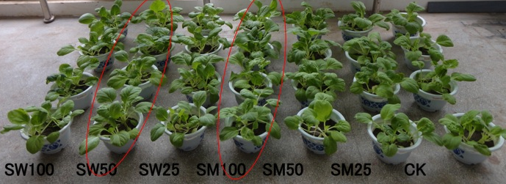
40-60% Enhanced Yield with Application of Foliar Spray
When using NPK Fertiliser
Wheat Straw BC (SW)
Maize Straw BC (SM)

Slide 53
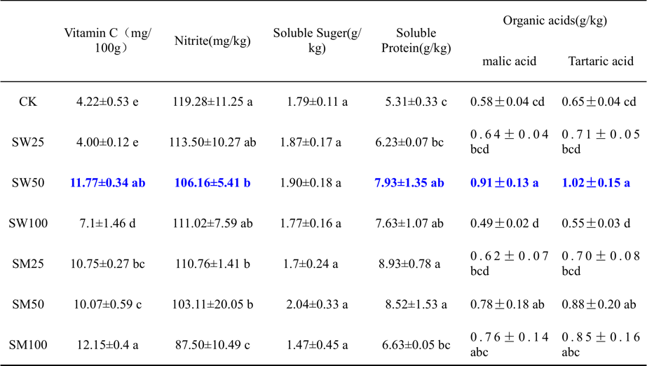
: Foliar Spray Increases the Quality of the Cabbage
Notes:
STEAM GASIFICATION: is the gasification of biomass using steam > 800°C to yield a producer gas. Heat is added indirectly to the biomass via a solid heat carrier or the steam to effect reaction.
OXYGEN GASIFICATION: is the gasification of biomass using either oxygen-enriched air or pure oxygen to yield a producer gas. Heat may be added indirectly to the biomass via a solid heat carrier to effect reaction.

Slide 54
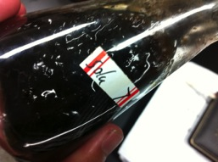
Liquid Fertiliser on Growth of Traditional Medicine
1 Take 10gms dry wheat straw black carbon，though 0.5 mm sieve。
Add 200ml water + 5.6gms (.5M) (KOH),
Heat for two hours in the oven 150C,
After heating the solution thickens
Filter the solid-liquid mixture
Add phosphoric acid，change pH to 7
After several minutes a gel is formed with a high humic acid content. When >50X water is added to the gel it dissolves completely
An Enhanced solution was made by adding 158mg/l of FeSO4 to increase the redox activity

Slide 55
Liquid Fertiliser on Growth of Traditional Medicine Bell Flowers; Field Trial results
b
a
a
a
a
b
c
d
a
b
Weight in kg
%
c
d
CK =fertilizer 600-750kg / ha, chicken manure 18-22.5t/ ha.
T1 = Watering the soil
T2 = Foliar Spray
T3 = Foliar spray and watering the soil

Slide 56
Preprocessing Option 1 For Solid Fertilisers
Possible Organic Macronutrients
Mineral (P)
Ash (K)
Fermented biomass, amino acids (N), guano, green manure (legume),
Inorganic Macro Nutrients
NPK, P, NP, N Chemicals
Micronutrients
Clay , basalt, dolomite, other minerals, sea weed)
Phosphoric and Citric
Acid
Biomass
(Straw +Manure+ Green waste)
Mix all ingredients and aerate with hot air from pyrolyser at 80C for minimum of 3 hours
+
Pelleting/Granulation
Drying
Heat
Wood Vinegar
Pyrolysing at 450C

Slide 57
Post Processing for Solid Fertiliser Option 2
Dry
Biomass
Condensed Liquid
Add to biochar
Minerals
Clay
Organic Source of N
Acid
Smoke water
Pyrolysing at 400-450C
Compost
Biochar
Pelleting/Granulation
Drying
References
Heat

Slide 58
Post Processing Option for Solid Fertiliser 3
Dry
Biomass
Condensed Liquid
Wood Vinegar
Acids (P and Citric)
High Temp Biochar
+
Rock Phosphate (P)
ash e.g. straw/grape mark (K)
Urine, fermented biomass, amino acids (N), guano, green manure (legume)
Inorganic Macro Nutrients
Potash (K), (Fe) Ammonium Sulphate, Urea (N); Mono ammonium phosphate (NP)
Micronutrients
Clay , Basalt, Dolomite, Gypsum, Sea Lime + Manganese sulphate + illmenite + Manure+ Straw Ash )
Pyrolysing at 400-450C
₊
Pelleting/Granulation
Biochar
Drying
Heat from Pyrolyser

